Slide 1
Collection of EDX Spectra for manuscript

Slide 2
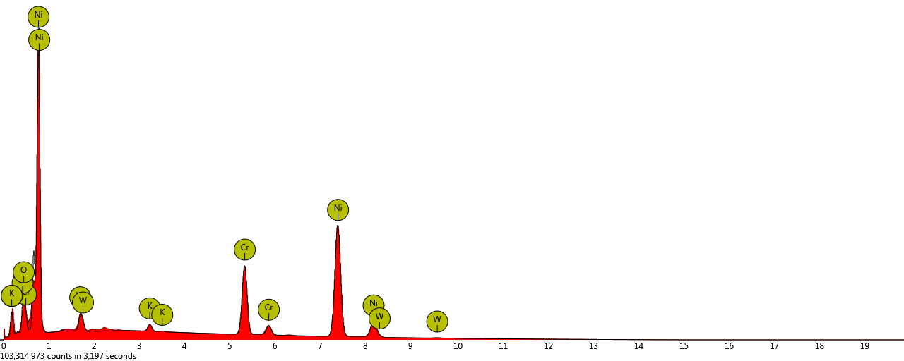
EDX spectrum for Figure 4

Slide 3
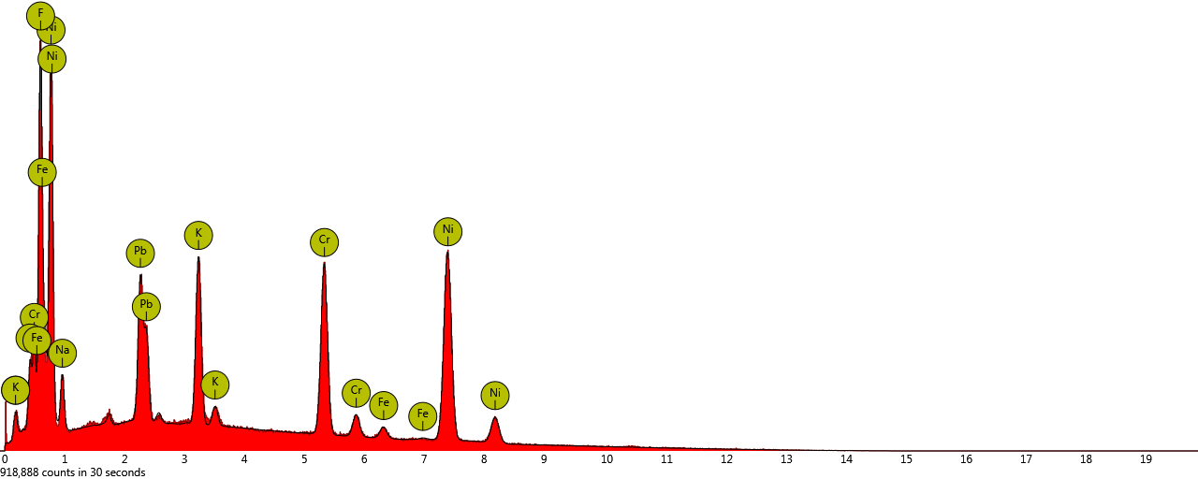
EDX spectrum for Figure 5a

Slide 4
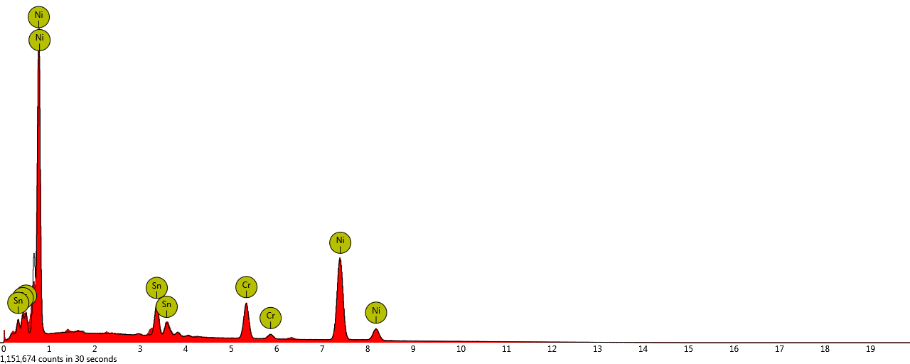
EDX spectrum for Figure 5b

Slide 5
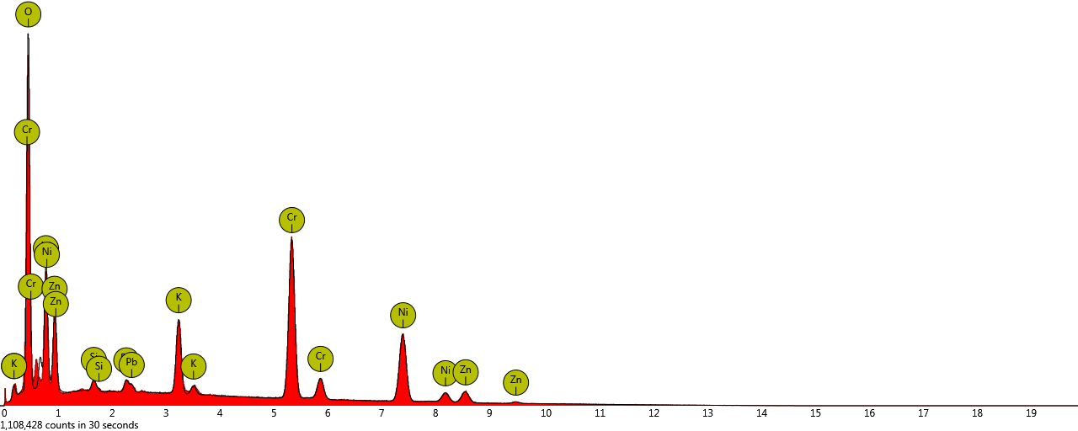
EDX spectrum for Figure 5d spot

Slide 6
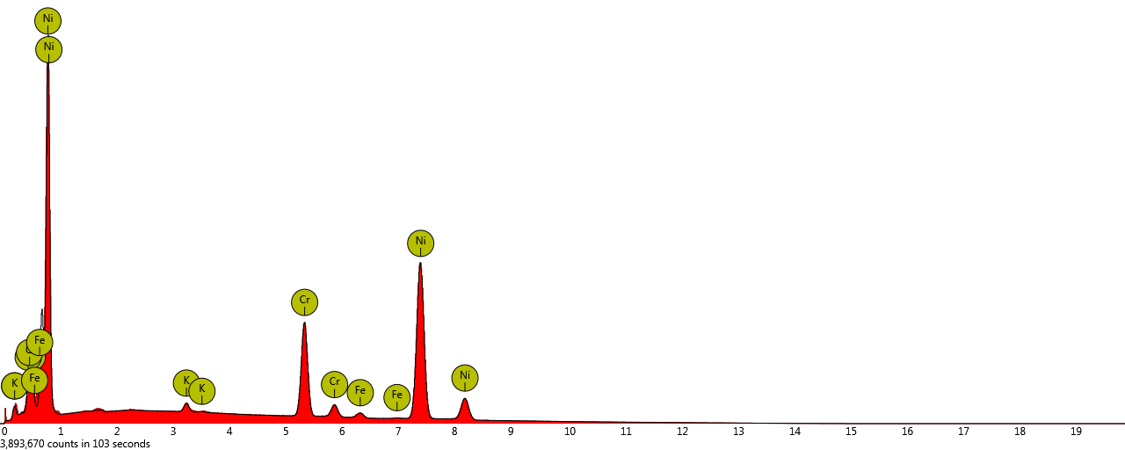
EDX spectrum for Figure 5d line

Slide 7
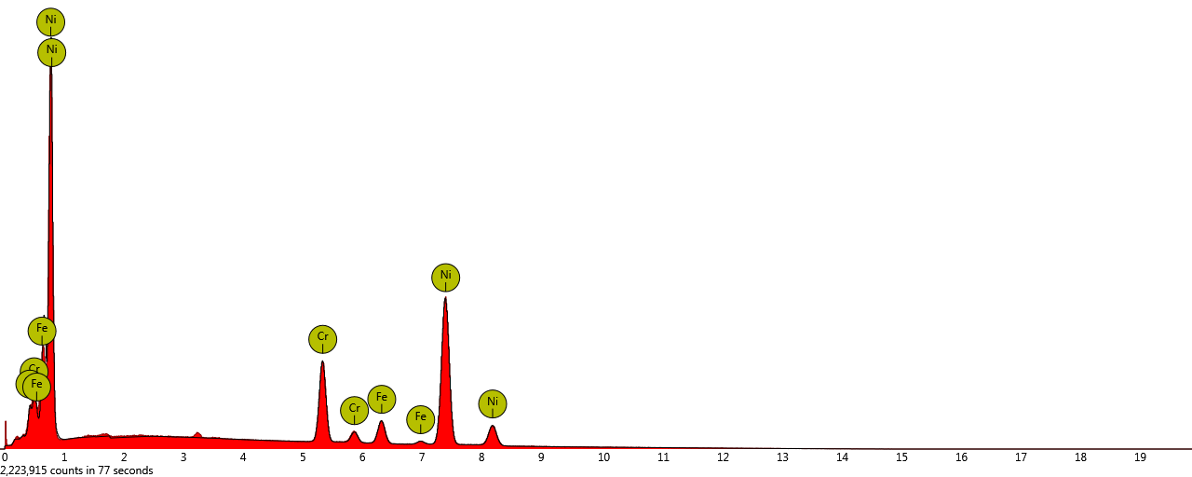
EDX spectrum for Figure 6a

Slide 8
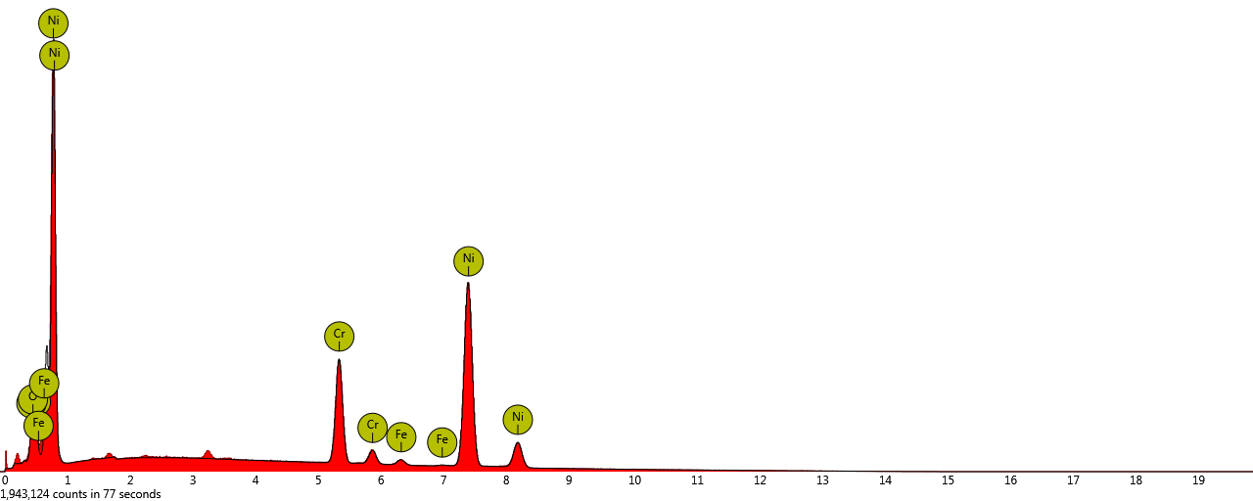
EDX spectrum for Figure 6b

Slide 9
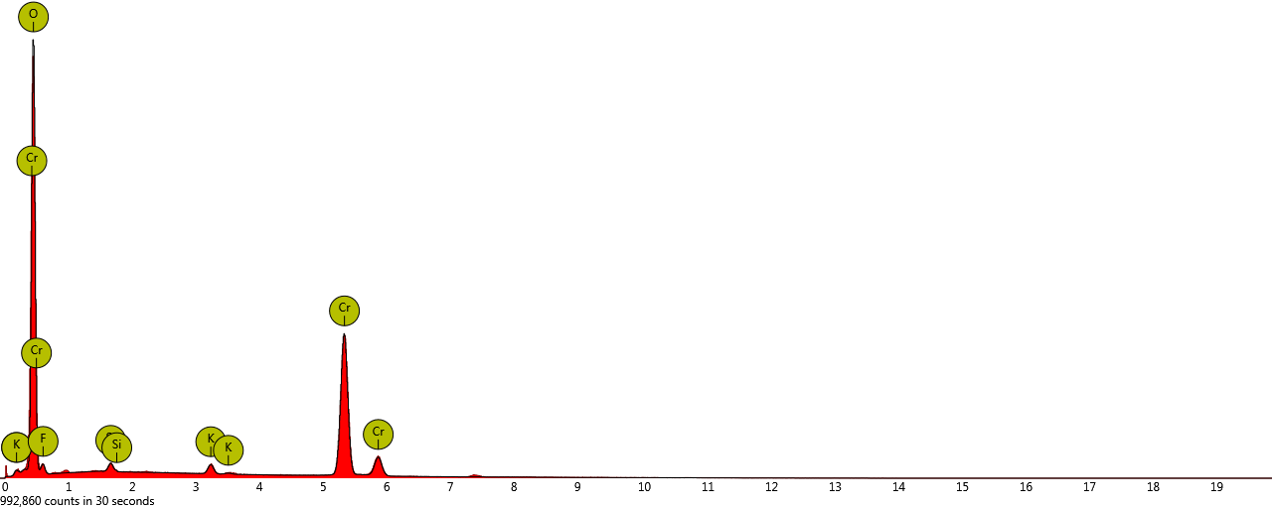
EDX spectrum for Figure 7a

Slide 10
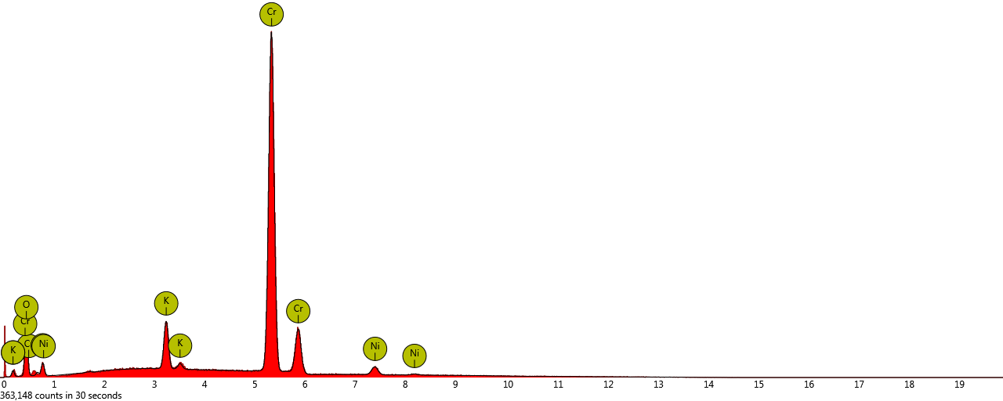
EDX spectrum for Figure 7b

Slide 11
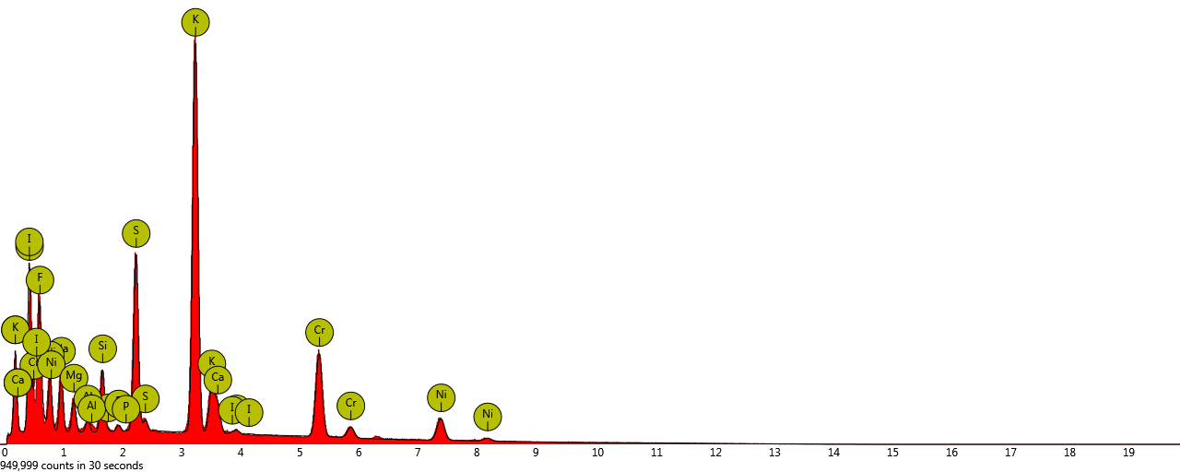
EDX spectrum for Figure 8a

Slide 12
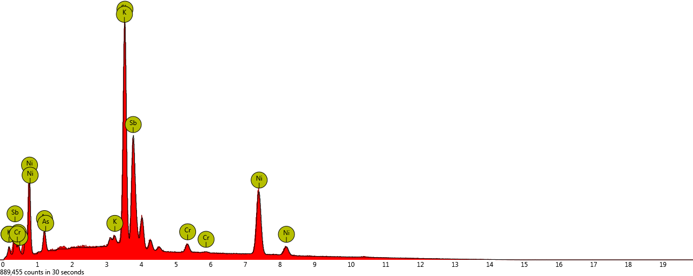
EDX spectrum for Figure 8b

Slide 13
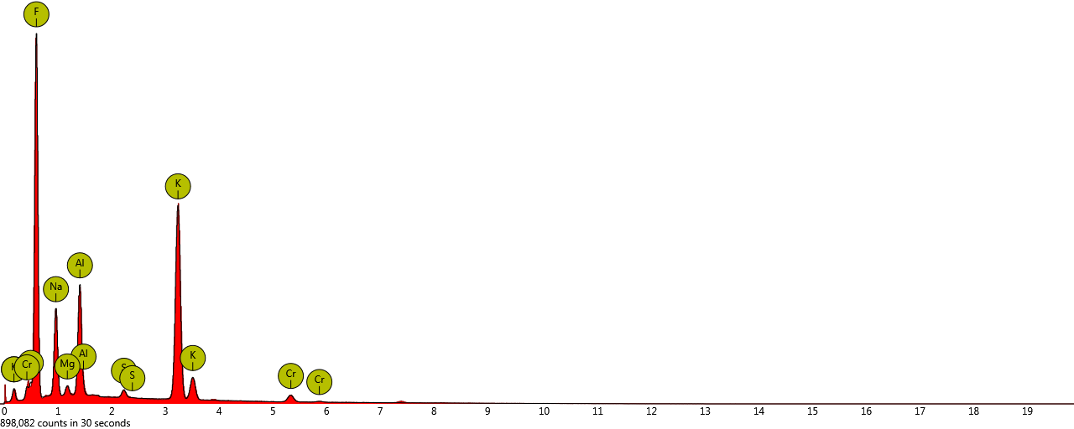
EDX spectrum for Supplementary Figure 3

